Slide 1
Long Island Population Health Improvement Project (LIPHIP)
March 15, 2017
This meeting is now being recorded.

Slide 2
PHIP Mission and Meeting Objectives
MISSION: The LIPHIP exists to assist the full spectrum of health and social service providers provide better healthcare, especially in the area of chronic disease, more efficiently and cost-effectively for all Long Islanders through population health activities.
Meeting Objectives:
Describe and understand meeting purpose -collective impact- and history of LIHC establishment
Recognize benefit in focus on evaluation strategies during year three of PHIP funding
Identify current LIHC workgroup projects
Explore integration of physical and behavioral health playing a key role in community improvement strategies
Understand focus of Creating Breastfeeding Communities Program and explore your partnership potential
Examine DSRIP and PHIP aligned projects

Slide 3
Collective Impact
Common Agenda
Common Progress Measures
Mutually Reinforcing Activities
Communications
Backbone Organization
Kania and Kramer, http://www.collaborationforimpact.com/collective-impact/

Slide 4
LIHC/PHIP Establishment and Role
February 2013: Voluntarily, stakeholders from across Long Island-hospitals convene to jointly work on Community Health Needs Assessments.
Areas of Focus
Chronic Disease
Obesity
Preventive Care and Management
Behavioral Health as an area of overlay within intervention strategies.
September 2014: New York State Department of Health introduces the Population Health Improvement Program (PHIP).
LIHC sponsored programs and initiatives belong to LIHC member organizations and follow the collective impact model.
The role of the PHIP team includes convening key players, building consensus, organizing projects and supporting the needs of members as related to population health strategies.
We are here for YOU!
December 2014: The Long Island Health Collaborative receives funding through the PHIP to become the primary work group associated with carrying out the goals of the PHIP grant.

Slide 5
Announcements
Meeting Structure
Evaluation Strategies
2017 National Walking Summit

Slide 6
Overview of workgroup projects
Data
Public Education Outreach and Community Engagement
Behavioral Health
Academic Partners
Cultural Competency

Slide 7
Population Health

Slide 8
Networking, Stretch Break & Sign up for Workgroup Participation

Slide 9
Pediatric Obesity Prevention: Creating Breastfeeding Friendly Communities
Steven & Alexandra Cohen Children’s Medical Center
Henry (Hank) Bernstein, DO, MHCM, FAAP
Pamela Reichert-Anderson, CLC, MA, RD, CDN
Anastasia Schepers, MS, RDN, CDN
Dawn Kempa, IBCLC, RN
Linda Stopsky, IBCLC, RN
Casidhe Bethancourt, CLC, BA
Shannon Cleary, BA
Ling Jing, BA
Tiffany Wang, CLC, BA

Slide 10
Breastfeeding Resiliency, Engagement, and Empowerment
(BFREE) Coalition
Our Mission
To establish a breastfeeding-friendly care continuum through pregnancy, the postpartum period, and infancy to reduce racial, ethnic and community disparities in breastfeeding prevalence.

Slide 11
BFREE Coalition
Our Vision
A majority of mothers in NYSDOH-selected Long Island communities continues breastfeeding for a minimum of 6 months, with a notable percentage doing so exclusively.

Slide 12
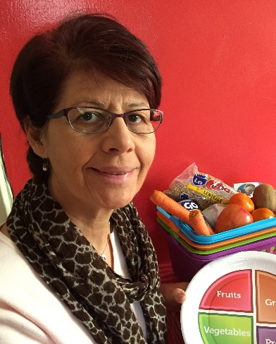
Meet the BFREE Team!
Henry (Hank) Bernstein
DO, MHCM, FAAP
Principle Investigator
Pamela Reichert-Anderson
CLC, MA, RD, CDN
Project Coordinator
Anastasia Schepers
MS, RDN, CDN
Project Coordinator
Dawn Kempa
IBCLC, RN
Program Administrator
Linda Stopsky
IBCLC, RN
Program Manager

Slide 13
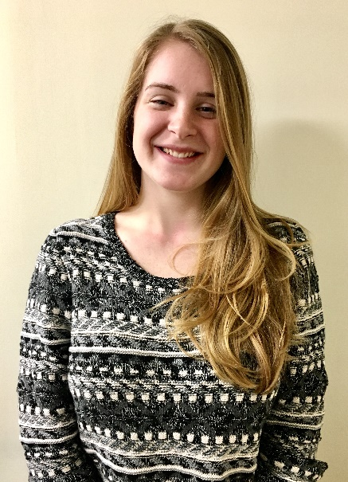
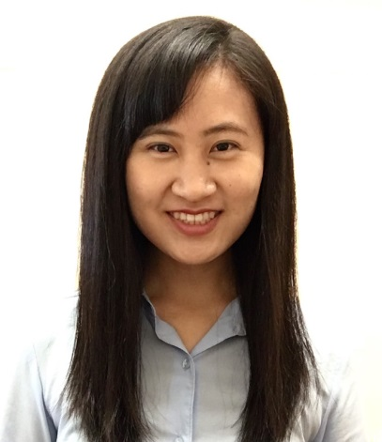
Meet the BFREE Team!
Casidhe Bethancourt
CLC, BA
Associate Project Coordinator
Shannon Cleary, BA
Associate Project Coordinator
Ling Jing, BA
Associate Project Coordinator
Tiffany Wang, CLC, BA
Associate Project Coordinator

Slide 14
Why Promote Breastfeeding?
Breastfeeding is hypothesized to have a protective effect against obesity later in life.^{1, 2, 3}
Arenz S, Ruckerl R, Koletzko B, von Kries R. Breastfeeding and childhood obesity—a systematic review. Int J Obes Relat Metab Disord 2004;28:1247–1256.
Metzger MW, McDade TW. Breastfeeding as obesity prevention in the United States: a sibling difference model. Am J Hum Biol. 2010;22(3):291–296
Owen CG, Martin RM, Whincup PH, Smith GD, Cook DG. Effect of infant feeding on the risk of obesity across the life course: a quantitative review of published evidence. Pediatrics. 2005;115(5):1367–1377

Slide 15
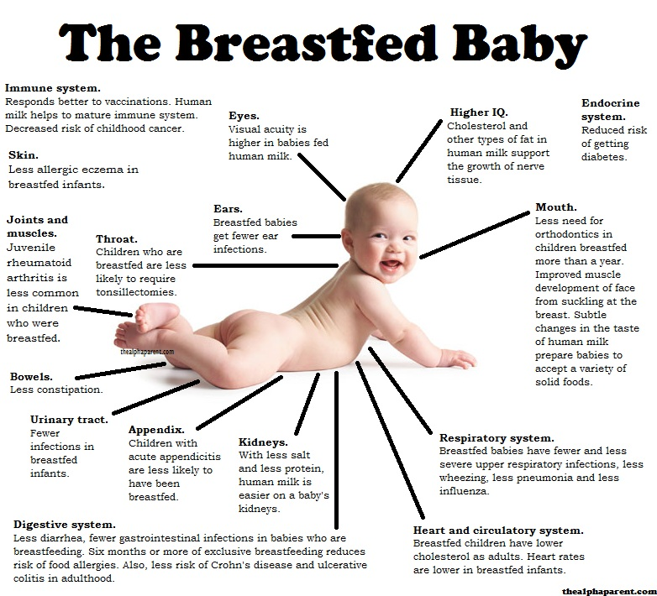

Slide 16
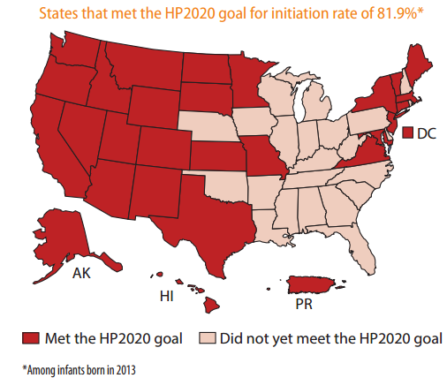
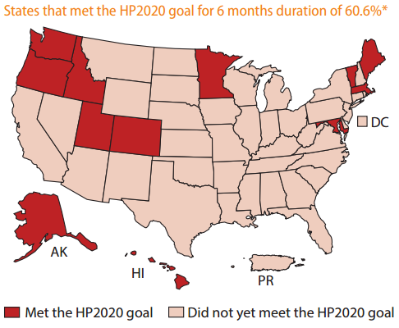
* Among infants born in 2013

Slide 17
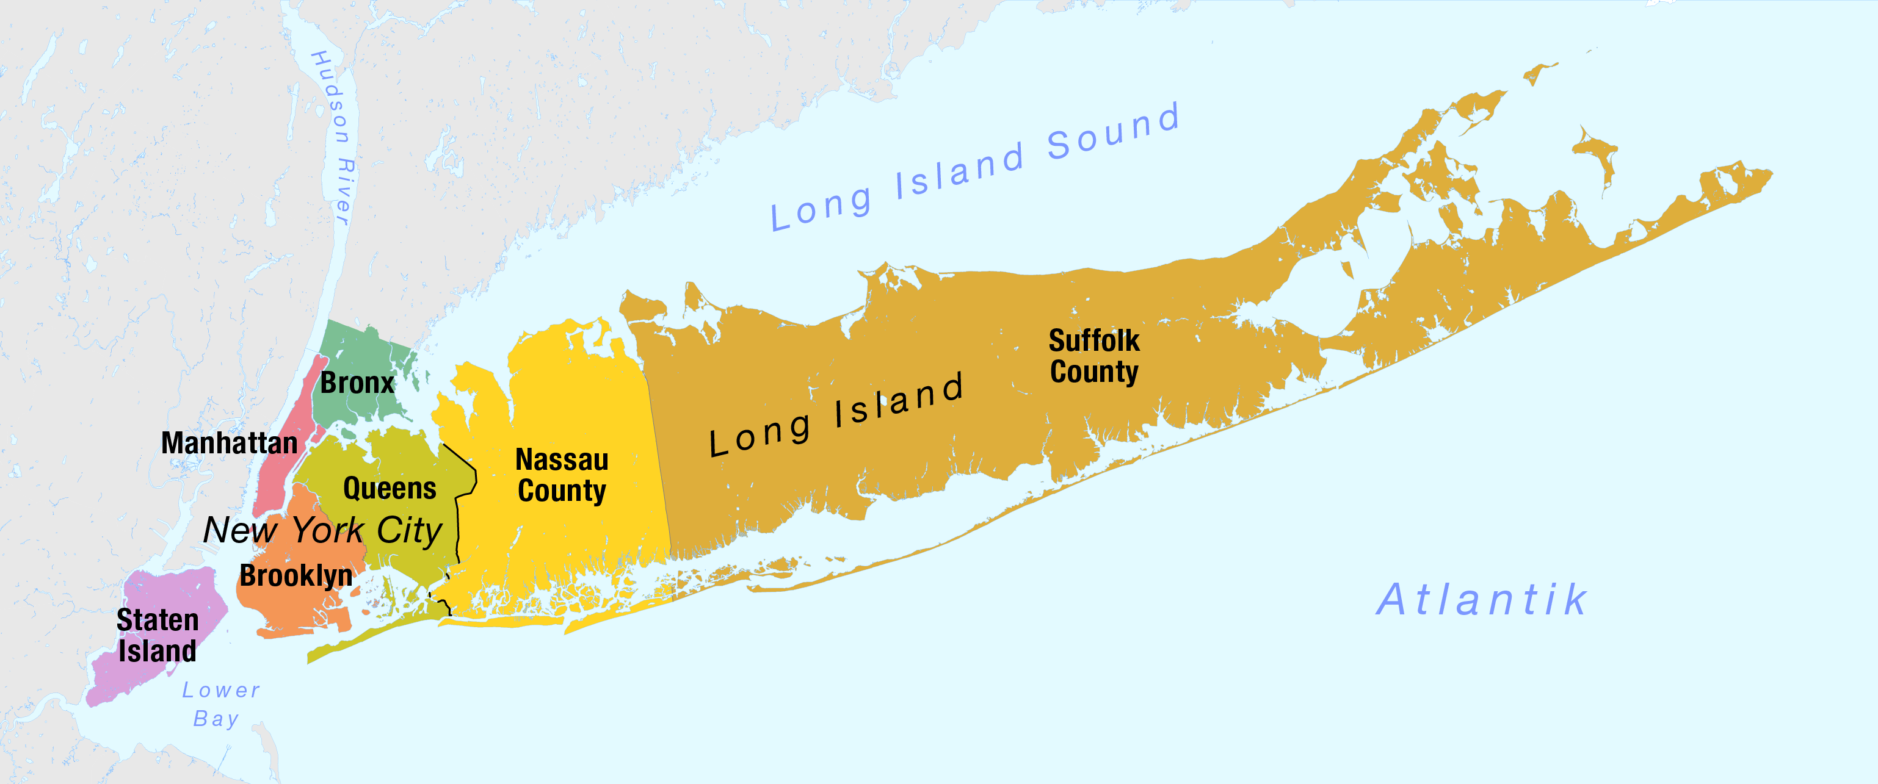
Creating Breastfeeding Friendly Communities Along the Care Continuum
Glen Cove
Southampton
Islip
Obstetric & Pediatric Practices
Child Care Centers/Day Care Homes
Work Sites
Baby Cafes®
Coalition Partners
Wyandanch

Slide 18
Clinical Practices
Glen Cove
Glen Cove Hospital Family Medicine
Glen Cove Hospital OBGYN
Glen Cove Pediatrics
Pediatric Healthcare Solutions
Islip
Contemporary Women’s Care
HRHCare Health Center at Brentwood
Islip OBGYN
Oakdale OBGYN
Southside Hospital Department of Pediatrics
West Islip Pediatrics
Women’s Health & Aesthetics
Southampton
HRHCare Kraus Family Health Center at Southampton
Shinnecock Nation Community Health Program
Wyandanch
HRHCare MLK, Jr. Health Center at Wyandanch
Partners
AAP Nassau Pediatrics Society
Allied Breastfeeding Program
Allied Physicians Group
Community Outreach Health Education Council
Creating Healthy Schools and Communities
Interagency Council of Glen Cove
Le Leche League of New York
Long Island Dietetic Association
Long Island Health Collaborative
Maternal and Infant Community Health Collaborative
Nassau County Department of Health
Shinnecock Nation Health Services
Suffolk County Bureau of Public Health Nursing
Suffolk County Department of Health
Suffolk Perinatal Coalition
Subcontractors
Child Care Council of Nassau, Inc.
Healthy Children Center for Breastfeeding
Sustainable Long Island
The Breastfeeding Resiliency, Engagement, and Empowerment (BFREE) Coalition
Cohen Children’s Medical Center of New York
General Pediatrics
Baby Cafes
Glen Cove
Glen Cove Public Library
GoHealth
Le Leche League of Queens (serves Glen Cove community)
Nassau County WIC
Planned Parenthood
Islip
Brentwood WIC
GoHealth
Southside Hospital
First Baptist Church of Bay Shore
Southampton
GoHealth
Le Leche League of Southampton
Southampton WIC
Wyandanch
GoHealth
Wyandanch WIC
Worksites
Glen Cove
Glen Cove Hospital
Glen Cove YMCA
Long Island Association
Islip
Bayport – Blue Point Chamber of Commerce
Bay Shore Chamber of Commerce
Great South Bay YMCA
Islip Chamber of Commerce
Long Island Association
Southside Hospital
Southampton
East Hampton YMCA (serves Southampton community)
Long Island Association
Wyandanch
Long Island Association
Day Care Homes / Child Care Centers
Glen Cove
Child Care Council of Nassau, Inc.
Islip/ Southampton/ Wyandanch
Child Care Council of Suffolk, Inc. (24)

Slide 19
Questions? Comments? Interested in becoming a part of the coalition?
Contact Us: BFREE@northwell.edu

Slide 20
FeedingYourBaby.org
Notes:
20

Slide 21
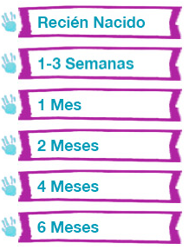
Notes:
21

Slide 22
Notes:
22

Slide 23
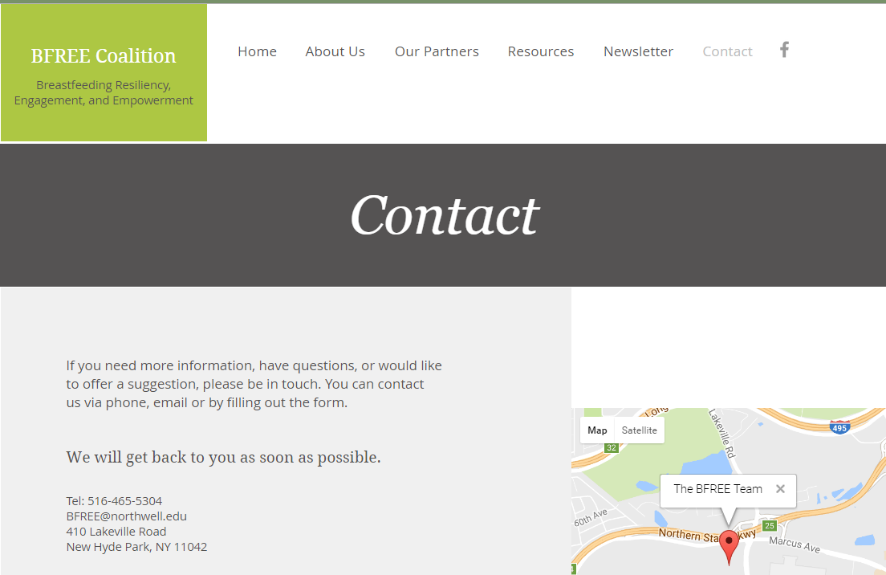
COMING SOON!
Notes:
23

Slide 24
Benefit Kitchen

Slide 25
DSRIP Partnership
Nassau-Queens PPS
Suffolk Care Collaborative

Slide 26
Upcoming Meetings
May 17, 9:30-11:30am
July 13, 9:30-11:30am

Slide 27
Questions/Feedback?

